Slide 1
Pre-Calc & Trig
Day 47

Slide 2
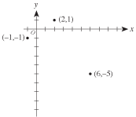
Bell Work
In the standard (x,y) coordinate plane below, 3 of the vertices of a rectangle are shown. Which of the following is the 4th vertex of the rectangle?
(3,–7)
(4,–8)
(5,–1)
(8,–3)
(9,–3)

Slide 3
I
wrote
a poem
in a tweet
but then each line grew
to the word sum of the previous two
until I began to worry about all these words coming with such frequency
because as you can see, it can be easy to run out of space when a poem gets all Fibonacci sequency

Slide 4
From Last Time
Day 1: Pg 394 #5-7, 11-19 (odd)
Day 2: Pg 394 #9, 27-30, 33-34, 49
Day 3: Pg 394 #21, 39-42, 63, 75

Slide 5
5.4 Sum and Difference Formulas
Objective: Use sum and difference formulas to evaluate trig functions, verify identities, and solve trig equations

Slide 6
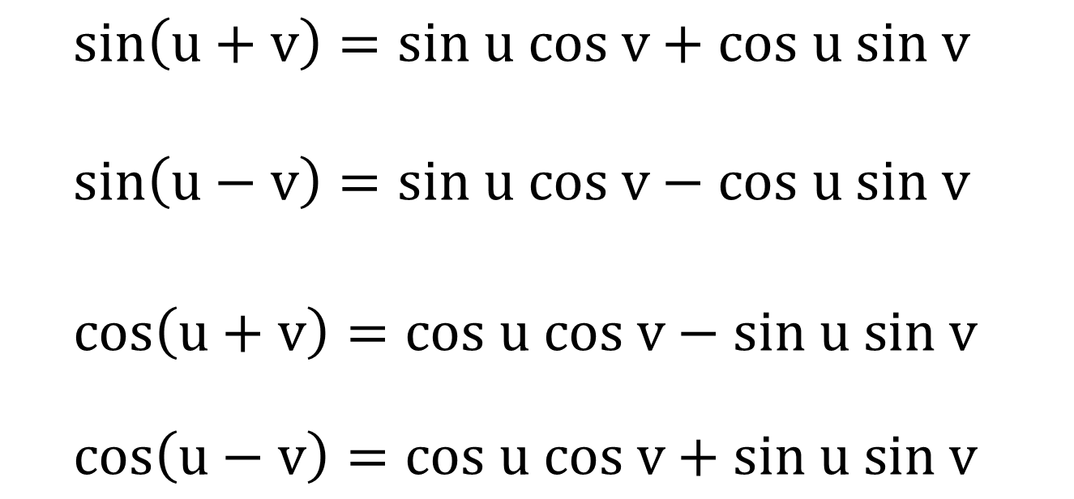
Sum and Difference Formulas [page 398]
$sin\left(u+v\right)=sin u cos v+cos u sin v$ $$sin\left(u−v\right)=sin u cos v−cos u sin v$$ $$cos\left(u+v\right)=cos u cos v−sin u sin v$$
$$cos\left(u−v\right)=cos u cos v+sin u sin v$$

Slide 7
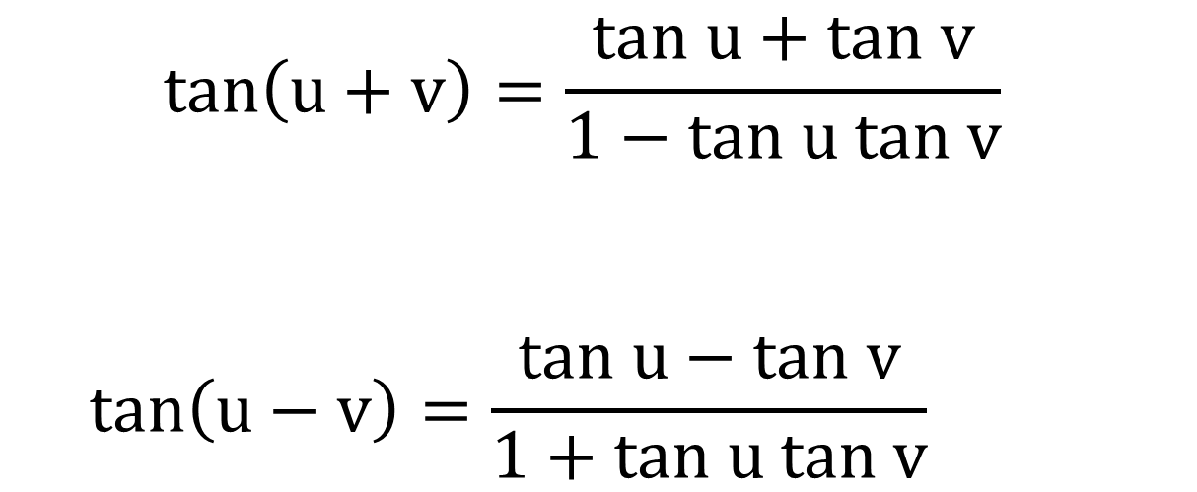
Sum and Difference Formulas [page 398]
$$tan\left(u+v\right)=\frac{tan u+tan v}{1−tan u tan v}$$
$$tan\left(u−v\right)=\frac{tan u−tan v}{1+tan u tan v}$$

Slide 8

Example 1 (Evaluate a Trig Function)
Find the exact value of $\sin{\frac{π}{12}}$

Slide 9
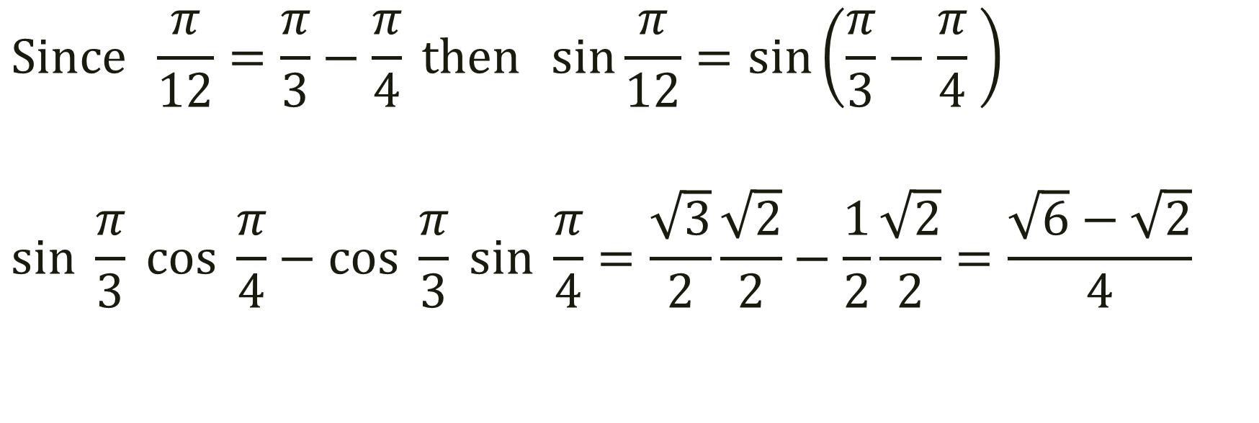

Find the exact value of $\sin{\frac{π}{12}}$
$$Since \frac{π}{12}=\frac{π}{3}−\frac{π}{4} then \sin{\frac{π}{12}}=\sin\left(\frac{π}{3}−\frac{π}{4} \right)$$
$$sin \frac{π}{3} cos \frac{π}{4}−cos \frac{π}{3} sin \frac{π}{4}=\frac{\sqrt{3}}{2}\frac{\sqrt{2}}{2}−\frac{1}{2}\frac{\sqrt{2}}{2}=\frac{\sqrt{6}−\sqrt{2}}{4}$$

Slide 10

Example 2 (Evaluate a Trig Function)
Find the exact value of $\cos{15°}$

Slide 11
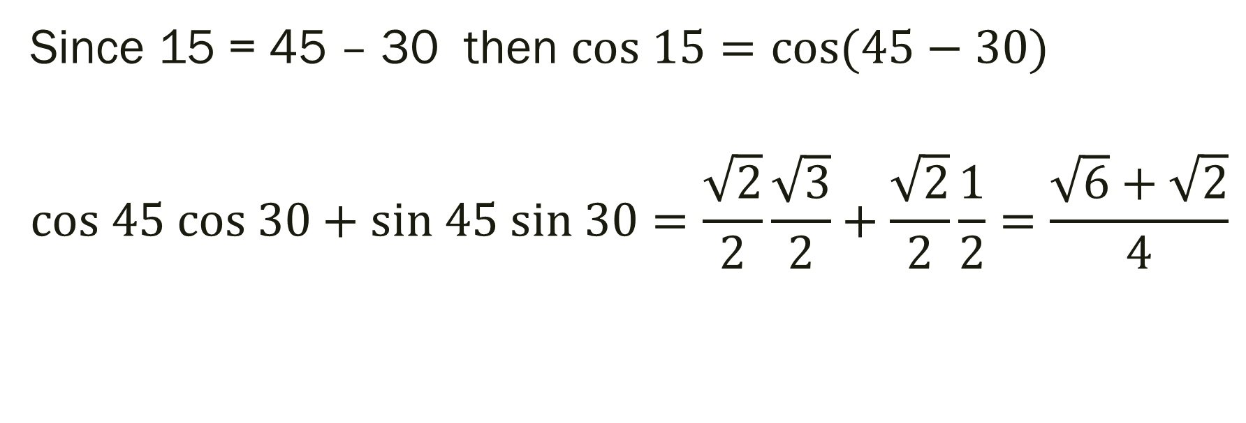

Find the exact value of $\cos{15°}$
Since 15 = 45 – 30 then $cos 15=cos{(45−30)}$
$$cos 45 cos 30+sin 45 sin 30=\frac{\sqrt{2}}{2}\frac{\sqrt{3}}{2}+\frac{\sqrt{2}}{2}\frac{1}{2}=\frac{\sqrt{6}+\sqrt{2}}{4}$$

Slide 12

Example 3 (Simplify the Expression)
Simplify: $\sin{(θ−\frac{π}{2})}$

Slide 13
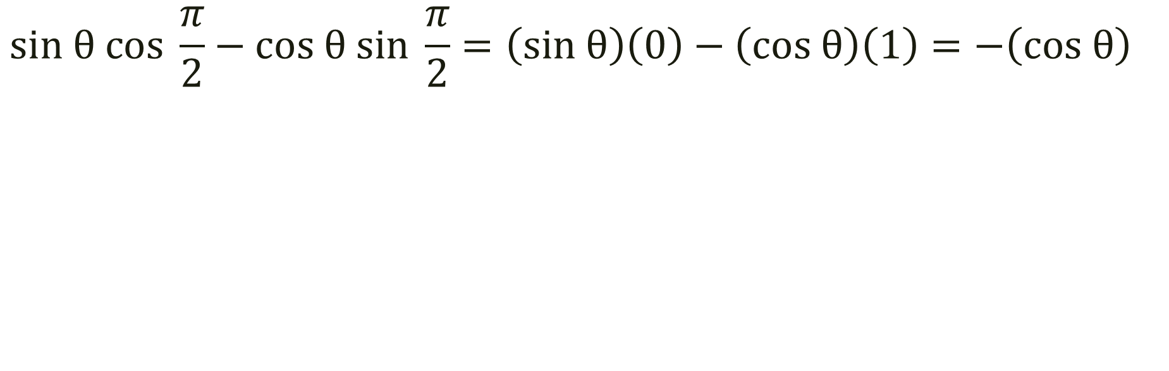

Simplify: $\sin{(θ−\frac{π}{2})}$
$$sin θ cos \frac{π}{2}−cos θ sin \frac{π}{2}=\left(sin θ\right)\left(0\right)−\left(cos θ\right)\left(1\right)=−\left(cos θ\right)$$

Slide 14
For Next Time
Pg 402 #7-13 (odd), 37-40

